Slide 1
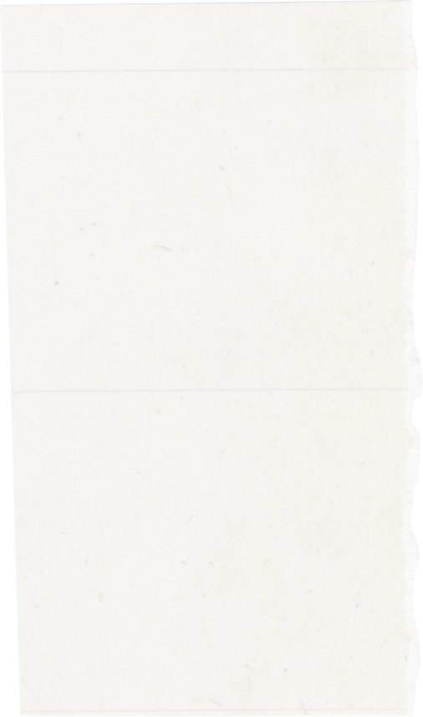


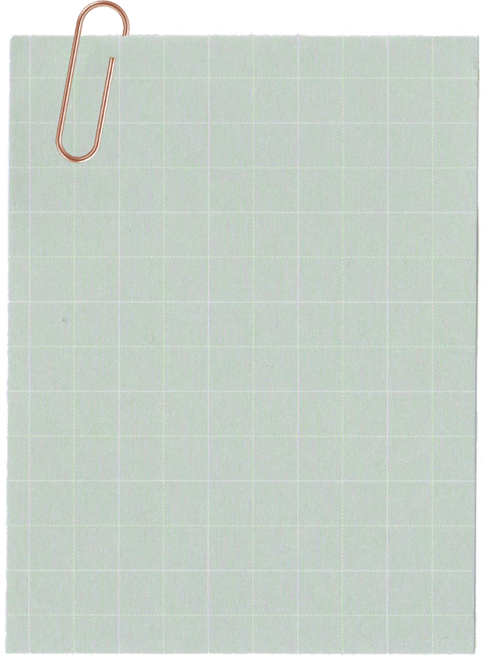
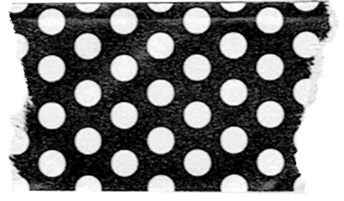
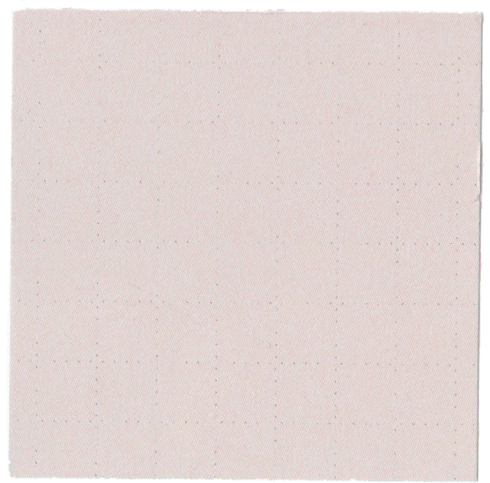
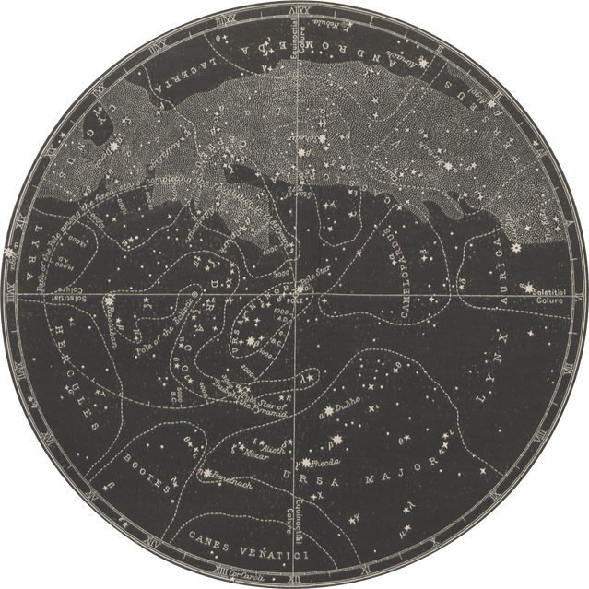
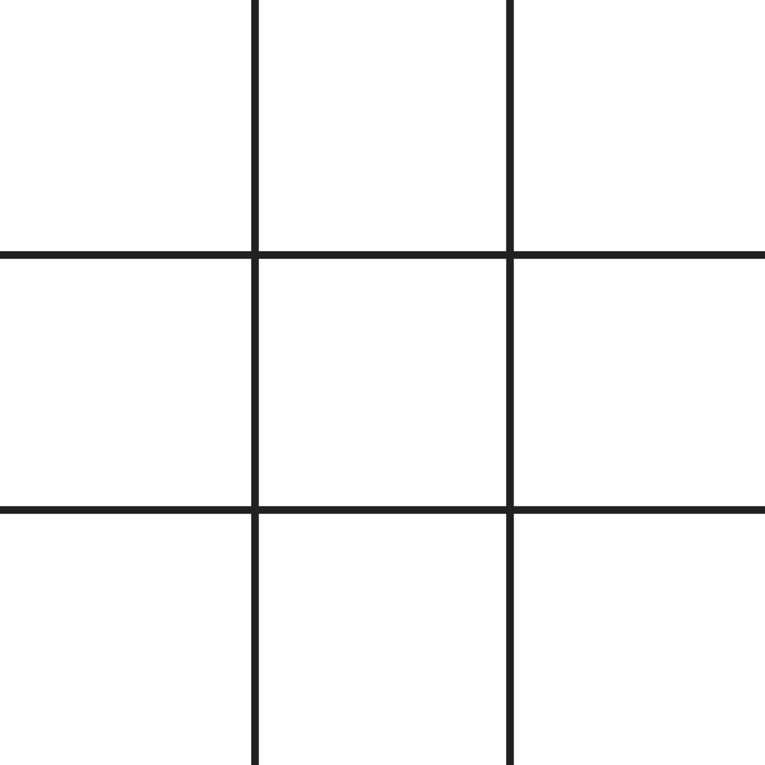



LET'S PLAY
TIC
TAC
TOE

Slide 2
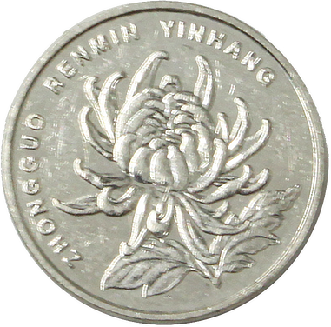
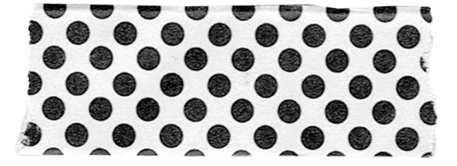

Introduction
A web-based Tic Tac Toe game.
Built using Flask, HTML, CSS, and JavaScript.
Simple, interactive, and engaging.

Slide 3
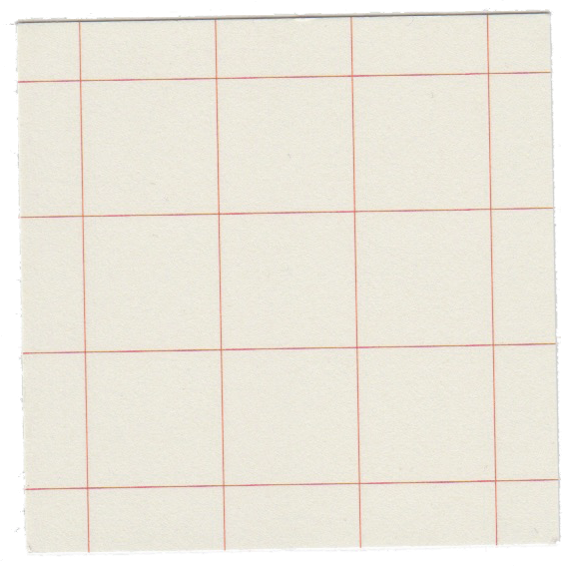
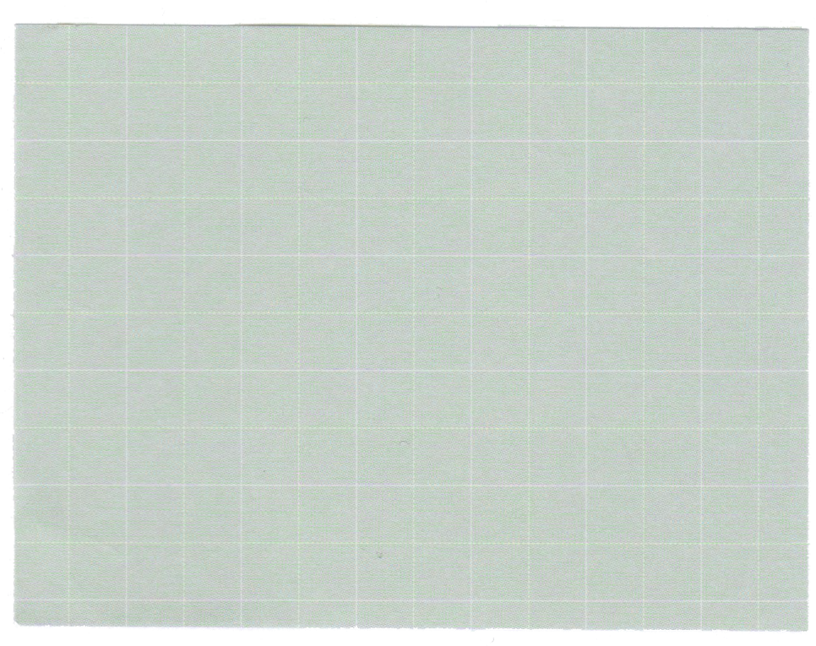
Game Flow
Two players enter their names.
They take turns placing X or O on a 3x3 grid.
The game checks for a winner or draw.
Players can restart and play again.

Slide 4
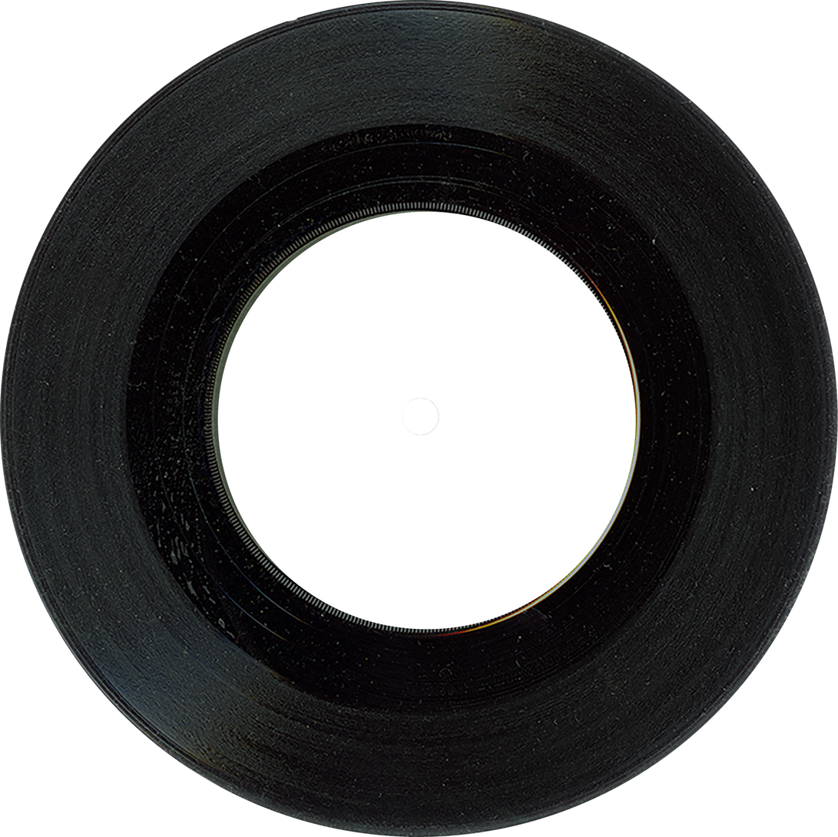
Flask in the Game
Flask manages the game pages and player names.
It handles requests and connects frontend to backend.
Runs the game on a local server.

Slide 5
Improving the Look
Dark theme for a modern design.
Hover effects for buttons and grid cells.
Winning row highlights for better visibility.

Slide 6

How the Game Works Internally
Tracks player moves and updates the board.
Checks for a winner after each move.
Restarts the game when needed.

Slide 7
Future Improvements 🚀
Play against AI (Single Player Mode).
Scoreboard to track wins and losses.
More themes and sound effects.
Better mobile compatibility.

Slide 8
Conclusion 🎉
A simple and fun Tic Tac Toe game.
Built using Flask, HTML, CSS, and JavaScript.
Can be improved with new features.

Slide 9
Thank you!
"Three in a Row, Victory to Show!"

